Slide 1

CS5200 Project:
2014 FIFA World Cup Database Management System
Team Name: Jizhi
Date:2015.12.10

Slide 2

Introduction
Requirements
Design
Discussion
Conclusion

Slide 3
Introduction
An operable database management system of the 2014 FIFA World Cup has been devised using MySQL, java and jdbc performed on Eclipse in this project
Functions：
Register and login
Users are divided into admin, second admin general user and guest
Inquiring the schedules
Information of every team and player
Submitting comments
All the implementations are realized by command line in eclipse.

Slide 4
Requirements
►ACTOrs
►use cases
Administrator [Admin]
Secondary Administrator [SecAdmin]
Registered User [User]
Guest [Guest]
User Registration [registerUser]
SecondaryAdministratorRegistration [registerSecAdmin]
Update Event [updateEvent]
Update Team [updateTeam]
Update Player [updatePlayer]
Query Event [queryEvent]
Query Team [queryTeam]
Query Player [queryPlayer]
Query Player Performance [queryPlayerPerformance]
Submit Comment [submitComment]
Log in [logIn]
Log out [logOut]

Slide 5
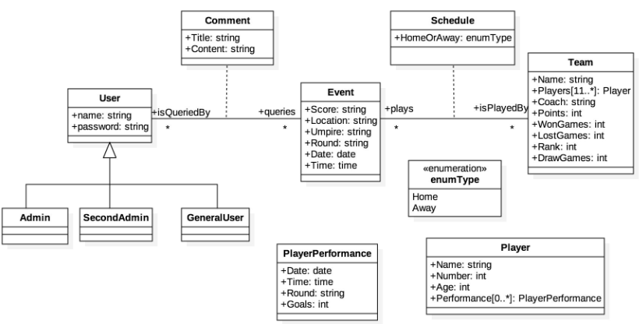
Design
Our database is built by the UML as shown in Fig.1:
Fig. 1 UML of FIFA2014 database management system

Slide 6
Discussion
Example： sign up as a new user， login and command on a match
Register
login
after registration, we login by name and password, and execute some operations.
comment
After a user’s comment being submitted, he can inquiry the match again and see his comment.
Enter 1 to see commands, and sign up as instructions.
Command line

Slide 7
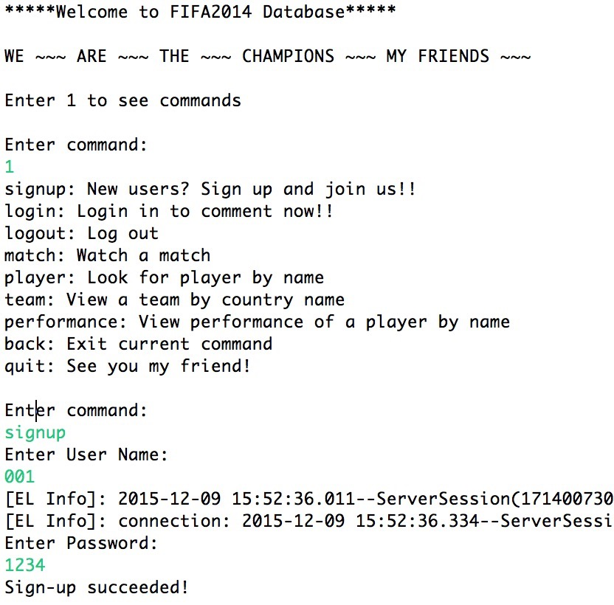
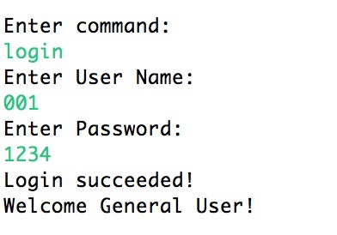
Discussion
►SCREENSHOT OF Execution
Fig. 2 Sign up as a new user Fig. 3 Login the system

Slide 8
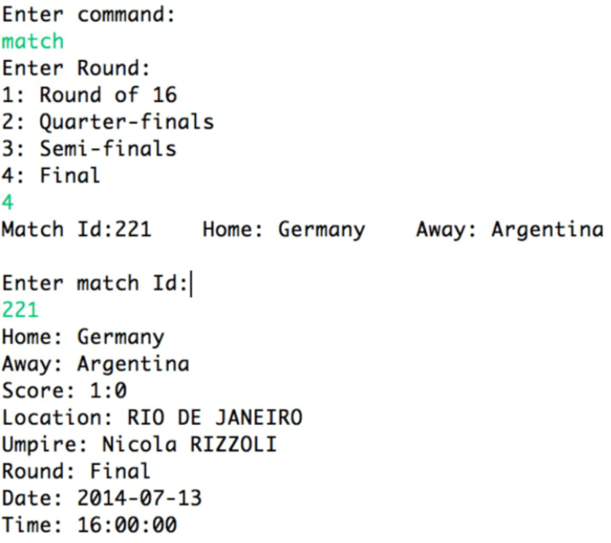
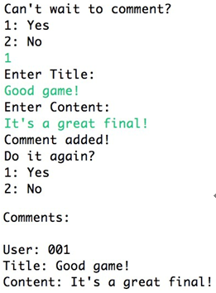
►SCREENSHOT OF Execution
Fig. 4 Inquiring a match Fig. 5 Comment

Slide 9
Conclusion
In this project, we devised a software by using MySQL, java and jdbc performed on Eclipse to provide a convenient database management system to get details of 2014 FIFA World Cup in this work, whose function contains inquiring the schedules of every event, the details of events, teams, and specific player’s performance, besides, we also add a function of comment to our system. All functions are implemented by operable command line, which are easy to master.

Slide 10
Reference
Database design and implementation. Sciore, Edward. Hoboken, NJ: John Wiley&Sons c2009
2014 FIFA World Cup Brazi - FIFA.com. (n.d.).: http://www.fifa.com/worldcup/archive/brazil2014/

Slide 11

Thank you !

